Slide 1

Computational Methods for Quantum Many-Body Systems (CMQMB) -
from artificial atoms to high-temperature superconductors
Lecture 1 – Introduction, Second Quantization
Prof. Dr. Thomas Schäfer Università degli studi di Trieste (UNITS), Winter Semester 2025

Slide 2

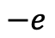
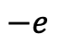
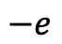
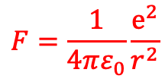
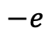
Fascinating physics from electron-electron interactions
→ repulsion
Classical electrostatics:
Coulomb force
$$−e$$
$$−e$$
$$F=\frac{1}{4πε_{0}}\frac{e^{2}}{r^{2}}$$
But Coulomb interaction can also lead to an (effective) attraction!
$$−e$$
$$−e$$
→ Cooper pairs and
superconductors

Slide 3
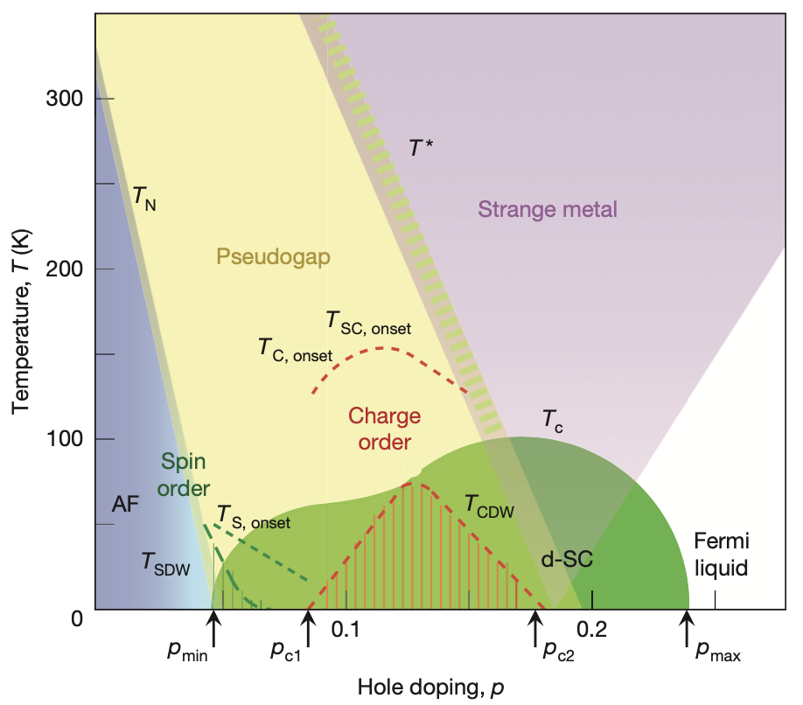
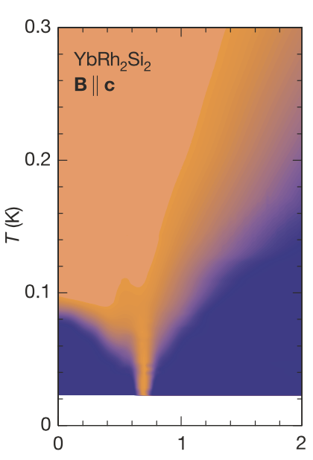
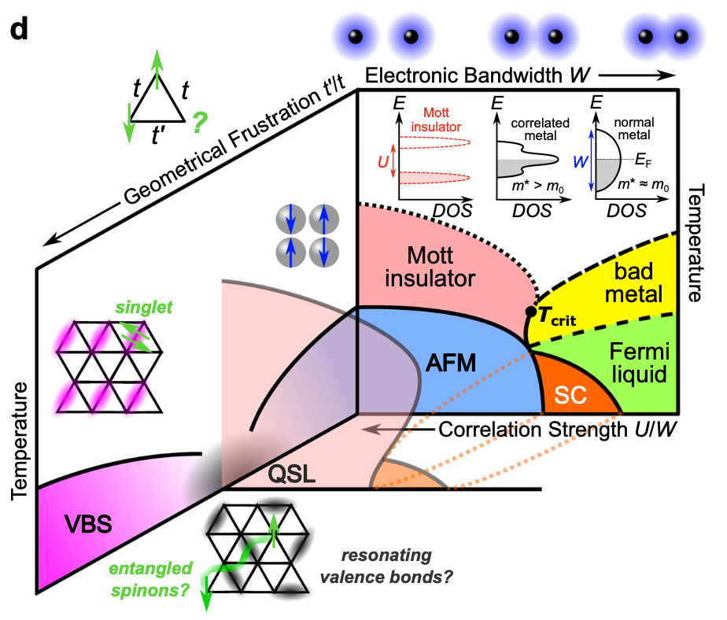
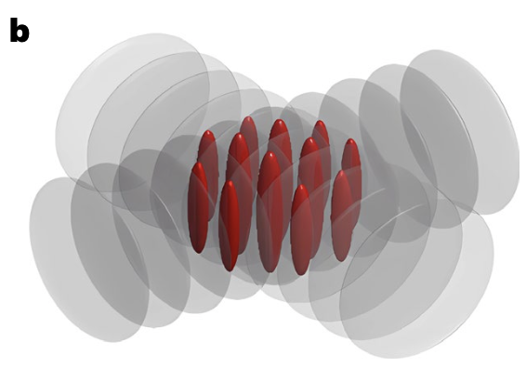
Fascinating physics from electron-electron interactions
High-T_{c} superconductivity, pseudogap
Quantum criticality/Strange metals
B. Keimer, et al., Nature (2015)
J. Custers, et al., Nature (2003)
Tseng, …, TS, Hansmann, SciPost Ph. ’25
Malcolms, …, TS, arXiv ‘24
Ortiz,…, TS, Hepting, PRR ‘22
Klett, …, TS, Front. Phys. ‘22
Kitatani, …, TS, Held, JPM ‘22
TS and Toschi, JPCM ‘21
Klebel-Knobloch, TS, …, PRB ‘21
Kitatani, TS, et al., PRB(R) ‘19
Gunnarsson, TS, et al., PRL ‘15
TS et al., PRL ‘17
TS et al., PRL ’19
Adler, …, TS, …, arXiv ’24
Kitatani, TS, …, arXiv ‘25
How can we treat such systems theoretically?
Mott metal-insulator transitions
“Artificial materials”/quantum simulators (cold atoms, moiré, …)
A. Pustogow, et al., Nat. Comm. (2023)
Menke, …, TS, PRL ’24
Meixner, …, TS, arXiv ‘25
Kowalski, …, TS, PRL ‘24
Meixner, …, TS, SciPost Ph. ‘24
Wagner, …, TS, …, Sangiovanni
Nat. Comm. ‘23
TS et al., PRX ‘21
Wietek, …, TS, Georges, PRX ‘21
Klett, …, TS, et al., PRR ‘20
TS et al., PRB ‘15
TS et al., JMMM ‘16
Y. Huo, …, H.-C. Nägerl, Nat. Phys. (2024)
Tscheppe, …, TS, PNAS ’24
D. Kiese, … TS, …, in preparation

Slide 4
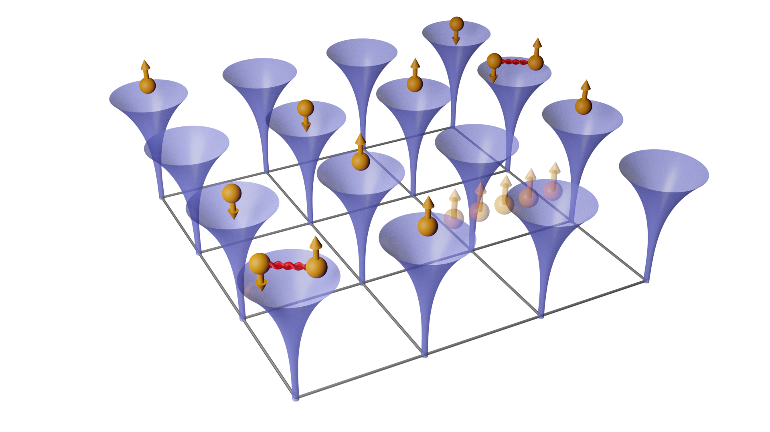
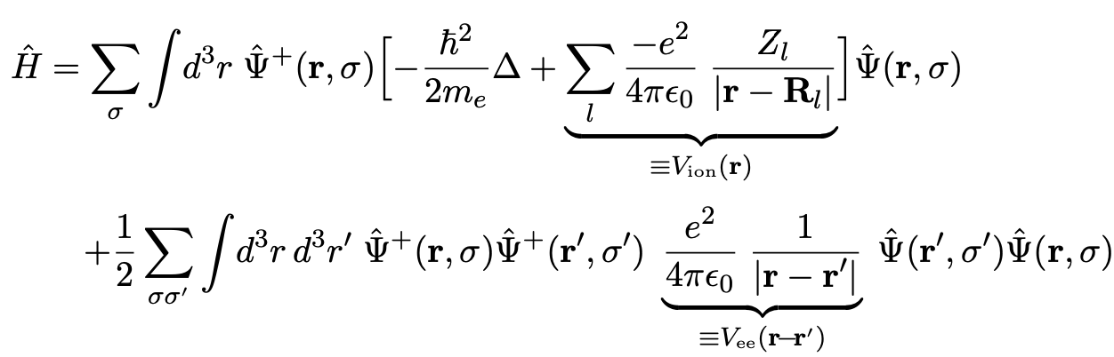
The full many-body (‘ab-initio’, solid-state) Hamiltonian
Problem: how can we treat a (quantum mechanical) system with 10²³ constituents?
Approximate solutions to H: density functional theory (DFT), perturbation theory, GW, etc.
Approximation to H: capture essential physics

Slide 5
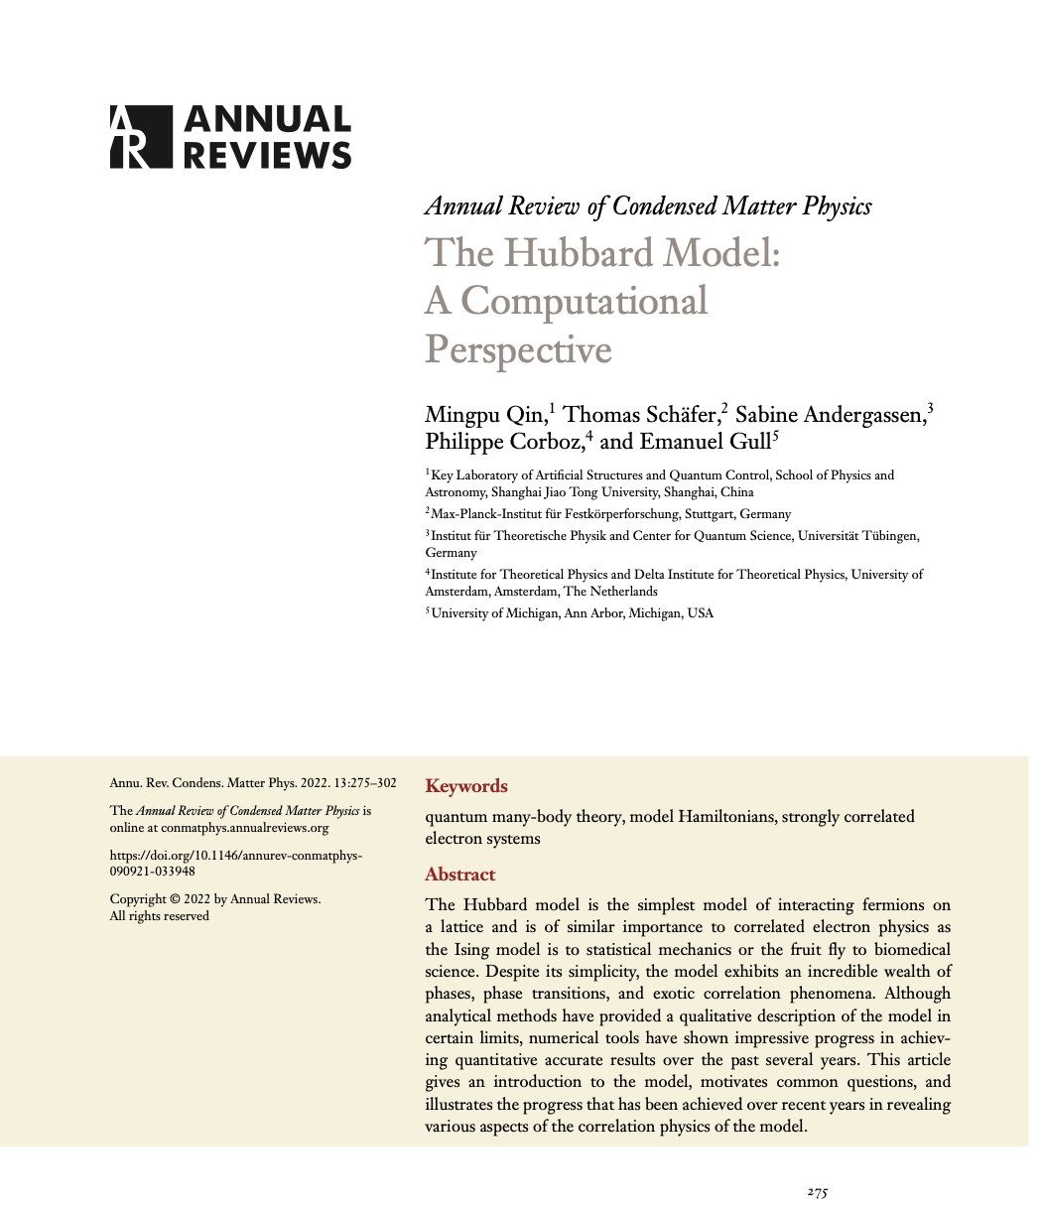
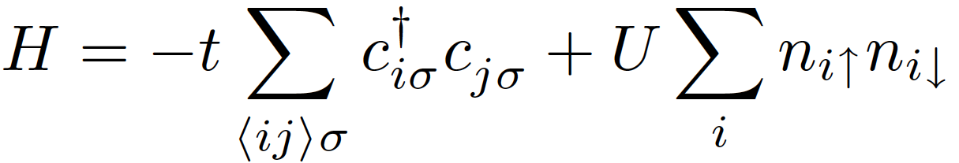
Interacting systems: fascinating physics - and a simple (?) modellization
Hubbard model
This model cannot be solved analytically in two and three dimensions! → numerical quantum many-body methods needed!
-t : hopping
U: local Coulomb
interaction
J. Hubbard, Proc. Royal Soc. A, 276, 238– 257 (1963)
M. Qin, TS, et al., „The Hubbard model – a computational perspective“, Annual Review of Condensed Matter Physics 13 (2022)

Slide 6
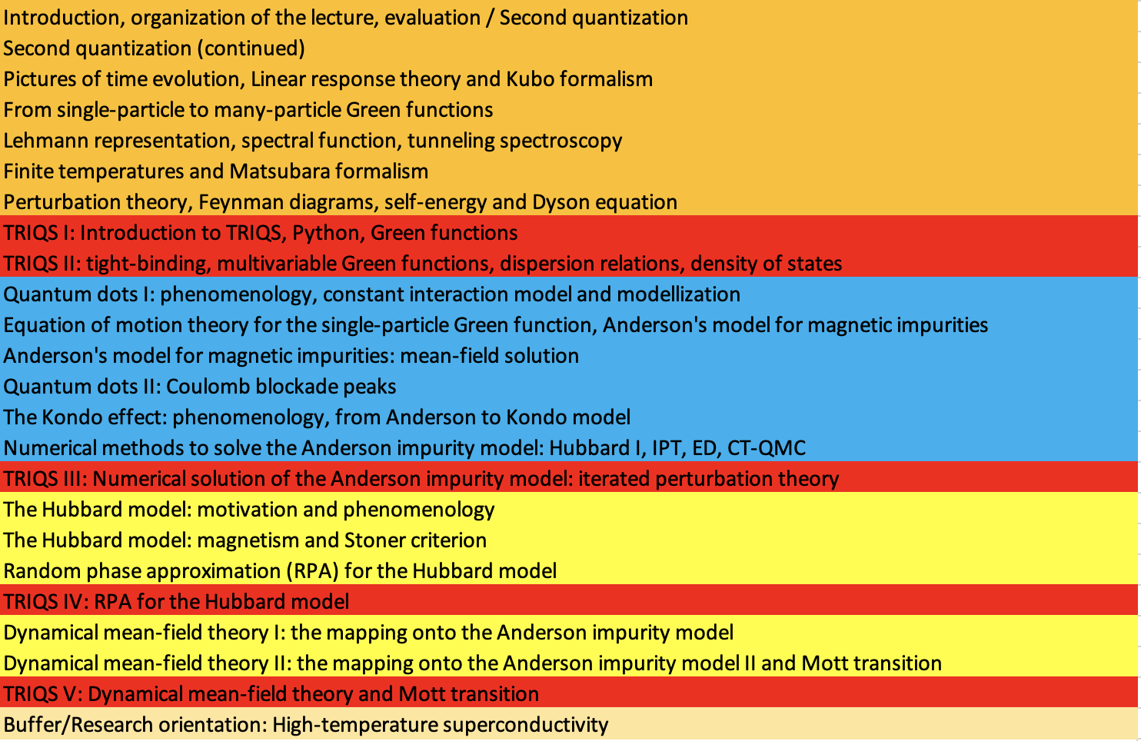
Tentative outline of the course
1. QFT and Green functions
2. Quantum dots, Anderson impurity model
3. Quantum magnetism, Hubbard model
4. Mott transition, DMFT

Slide 7

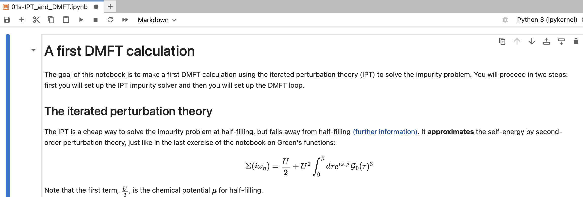
Numerical hands-on example sessions
Toolbox for Research on Interacting Quantum Systems
Introduction to topic and presented example (30 minutes)
Notebook to be worked on separately (40 minutes)
Presentation of solution (20 minutes)
LAPTOPS NEEDED! GOOGLE ACCOUNT NEEDED!
https://triqs.github.io/triqs

Slide 8
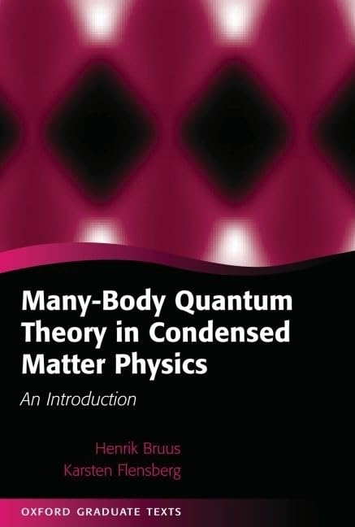
Course material
Lecture notes (blackboard and slides)
Numerical parts: notebooks
Book: H. Bruus and K. Flensberg “Many-body quantum theory in condensed matter physics” (Oxford Graduate Texts 2004)
Research papers and reviews (given in lectures)

Slide 9



Interested in Computational Methods for Quantum Many-Body Systems?
Thomas Schäfer
Mon 9:15 – 11:00 Aula B (Edificio F) Tue 11:15 – 13:00 Aula A Idraulica (Edificio C2)
Via Valerio, 2 - 34127 Trieste
Strada Costiera, 11 - 34151 Trieste
Office 252
thomas.schaefer@units.it

Slide 10

Possible exam modi of the course
Students can choose one of the following options (all orally):
Examination with two questions on the course from two different topics (30 minutes).
Presentation of a small numerical project worked out by the student (15 minutes) and one question on the course (15 minutes).
Presentation of a current research publication by the student (20 minutes) and one question on the course (10 minutes).

Slide 11
Computational Methods for Quantum Many-Body Systems (CMQMB) -
from artificial atoms to high-temperature superconductors
Lectures 1+2 – Second Quantization

Slide 12
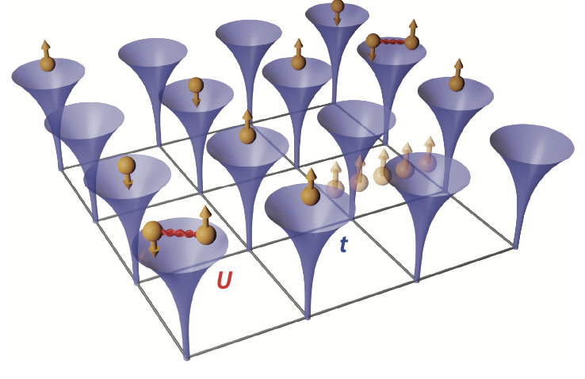
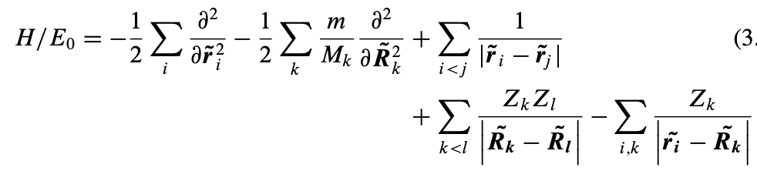
The full solid-state Hamiltonian
Many fascinating phenomena like magnetism, superconductivity, quantum criticality, metal-insulator transitions, …
However: advanced description necessary! One-particle picture does not hold!

Slide 13
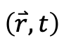
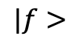
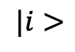
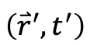
Towards interacting systems…
How can we obtain information from an interacting system?
→ Scattering experiments (theory)
$$|f>$$
$$|i>$$
$$\left({\overset{⃑}{r}}^{′},t^{′}\right)$$
$$\left(\overset{⃑}{r},t\right)$$
Three ingredients necessary:
Many-body treatment → Second quantization
Time evolution → Pictures of time evolution
How does the system respond? → Linear response theory

Slide 14
Lectures 1 + 2
Content and goals
Many-body wave functions in first quantization
Operators in first quantization
Occupation number representation
Creation and annihilation operators for bosons and fermions
Operators in second quantization
Change of basis and quantum field operators
Examples

